Slide 1

Dynamic Linear Models
By: Chandra Sekhar Reddy E

Slide 2
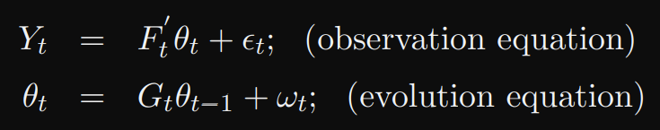
What Are Dynamic linear models?
Dynamic Linear Models (DLMs) are statistical models that combine linear models (linear regression model) and state space models(time-varying variance) for time series data analysis and prediction.
Particularly useful for modeling data that has both a stochastic trend and stochastic volatility.
They are useful for modeling time-varying relationships between variables, handling time-dependent error structures, and analyzing a wide range of time series data

Slide 3

DLM vs Regular Linear models
Dynamic Linear Models (DLMs) use a state space representation, which models the relationships between variables as well as the error structure in the data. It allows for the modeling of time-varying relationships and uncertainties in time series data.
Regular linear models, on the other hand, use a fixed regression approach, which assumes constant relationships between variables and a constant error structure in the data. This approach is limited in its ability to handle complex relationships and uncertainties in time series data.

Slide 4
Applications of DLMs
Energy Forecasting: In the energy sector, DLMs can be applied to model time-varying relationships in energy demand and supply data, such as electricity consumption and generation from renewable sources.
Financial Modeling: DLMs are used in finance to model time-varying relationships in financial data, such as stock returns and volatility.
Ecological and Environmental Modeling: The dynamic linear models are also useful in ecological and environmental modeling, where they help to understand the time-varying relationships in data such as animal populations and atmospheric CO2 levels.
Healthcare Modeling: DLMs are used in healthcare to model time-varying relationships in patient data, such as vital signs and lab results.

Slide 5
Literature Review (DLM for energy prediction)
Energy prediction of CUDA application instances using dynamic regression models
Dynamic linear modeling of monthly electricity demand in Japan: Time variation of electricity conservation effect

Slide 6
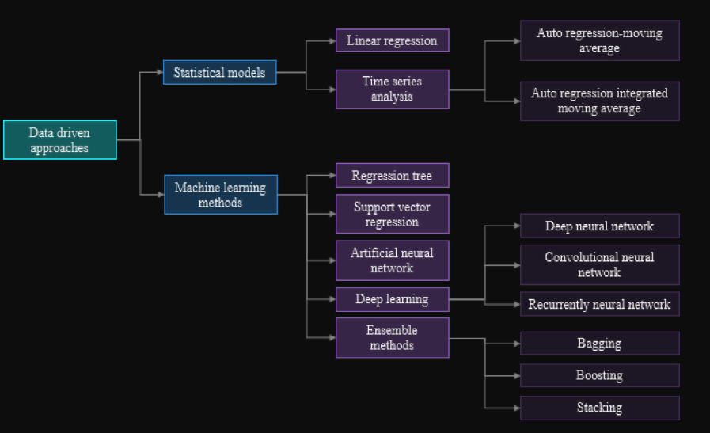
State-of-the-art in Energy prediction
The field of energy prediction has seen extensive use of machine learning and deep neural network models.
The Dynamic Linear Model remains an understudied approach in this field.

Slide 7
Thank You!

